Slide 1


Team Details
Team name: Mythrasphere
Team leader name: M.Janani Surya Kala
Problem Statement: Students lack easy access to reliable mentorship for academics, career, and personal guidance, creating a need for a simple platform to connect them with real mentors.

Slide 2
Brief about your solution
Saathi is a student support platform that connects students with experienced mentors for guidance in academics, career decisions, and mental well-being. The platform allows users to explore different categories, view mentor profiles, and directly connect with mentors through a simple and user-friendly interface.

Slide 3
Opportunities
How different is it from any of the other existing ideas?
How will it be able to solve the problem?
USP of the proposed solution
a. How is it different? Unlike traditional platforms, Saathi focuses on peer-to-peer mentorship and provides category-based guidance (study, safety, health, jobs) in one place. B. How does it solve the problem? It reduces confusion by: Providing direct mentor access c. USP Simple and clean UI Multi-category mentorship

Slide 4
List of features offered by the solution
User Registration & Login Category Selection (Study, Safety, Health, Jobs) Mentor Listing Mentor Profile View Connect with Mentor Chat Interface (basic prototype) Clean and intuitivebasic prototype)Clean and intuitive

Slide 5
Wireframes/Mock diagrams of the proposed solution (optional)

Slide 6
Architecture diagram of the proposed solution
Mentor data is fetched dynamically from the database.
User (App) → Frontend (UI) → Backend Server → Database

Slide 7
Technologies to be used in the solution
Design: Figma Frontend (future): HTML, CSS, JavaScript Backend (future): Node.js Database (future): Firebase / MongoDB

Slide 8
Estimated implementation cost (optional)
Development: ₹0 (student project) Tools: Free (Figma) Hosting (future): Minimal / scalable

Slide 9
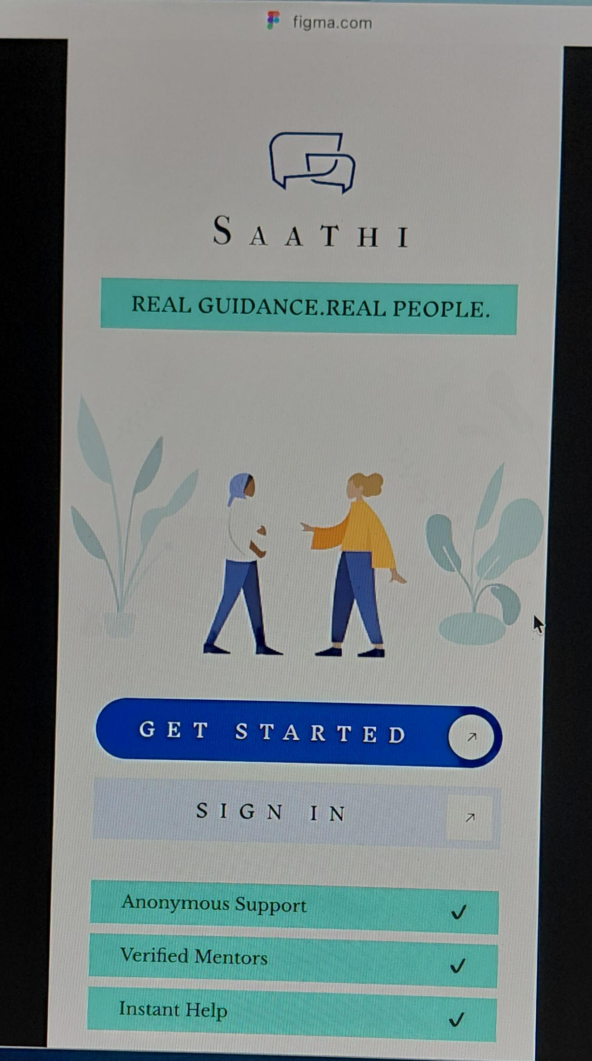
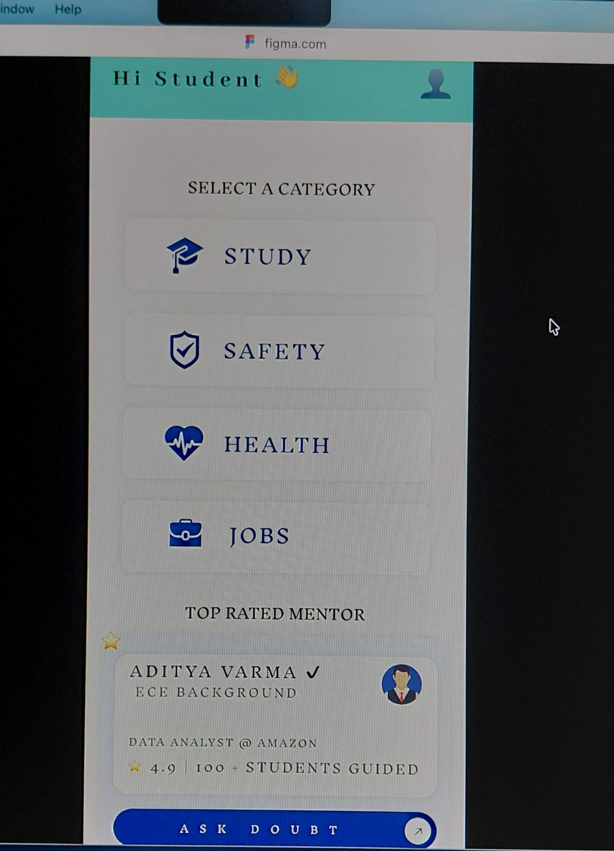
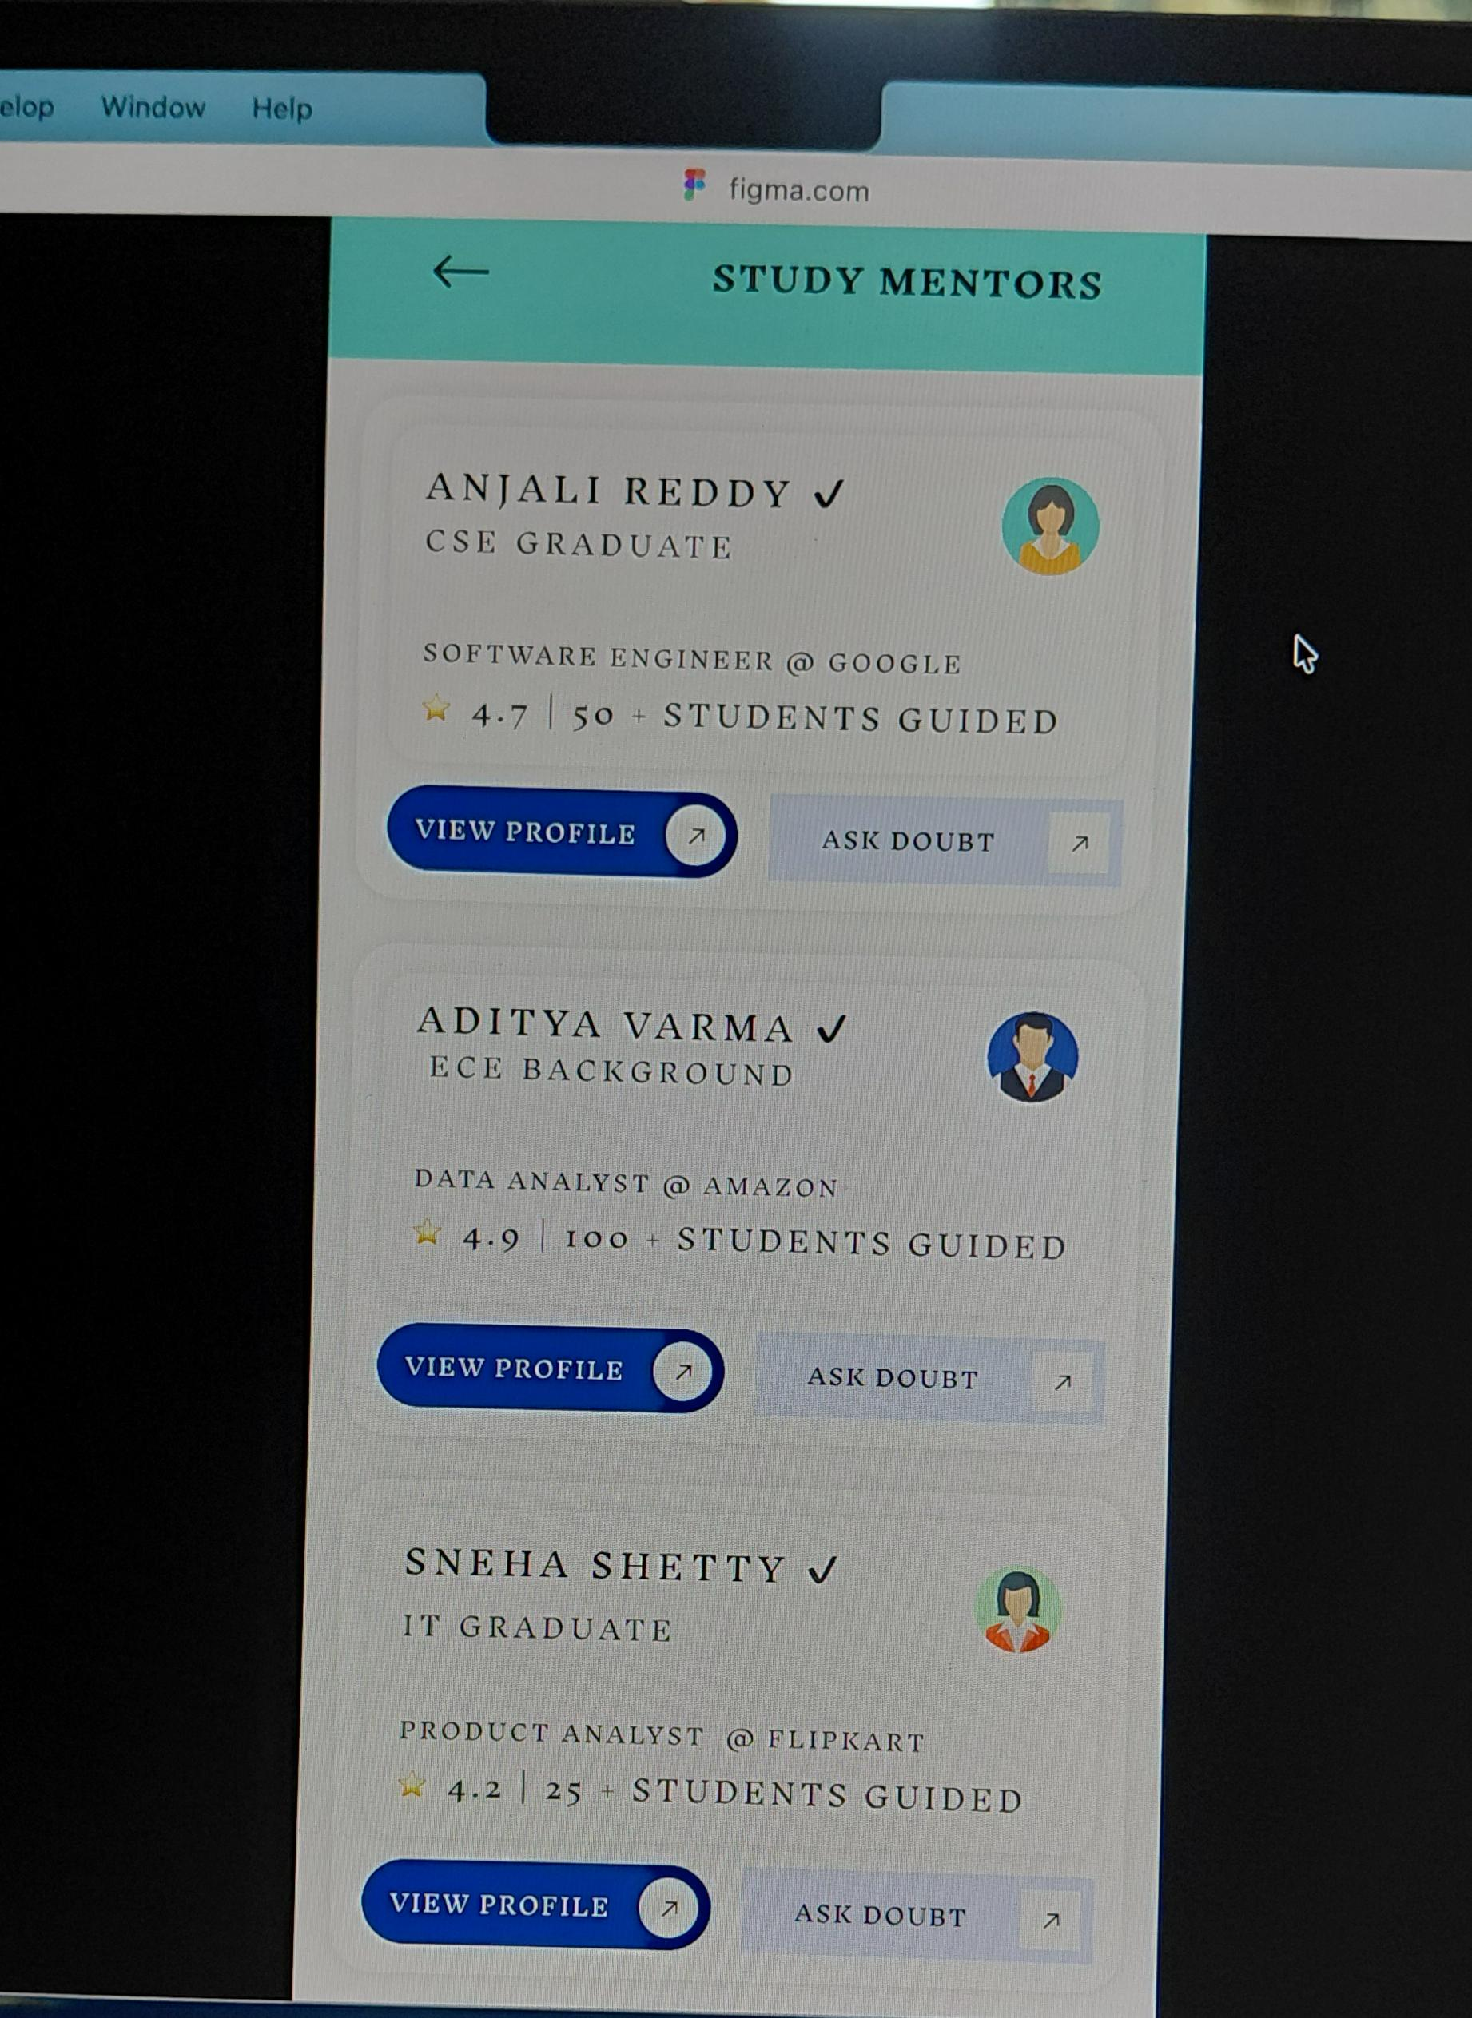
Snapshots of the MVP

Slide 10
Additional Details/Future Development (if any)
Real-time chat system AI-based mentor recommendation Verified mentor system Multi-language support

Slide 11
Provide links to your:
GitHub Public Repository
Demo Video Link (3 Minutes)
MVP Link
Working Prototype Link
GitHub Public Repository : Will be added
Demo Video Link : https://drive.google.com/file/d/1iSEdtyBEh2iW3soddW2-8bA7zaa1rTjs/view?usp=drivesdk
MVP Link : “Figma Prototype Link (MVP)”
Working Prototype Link : https://www.figma.com/proto/STBdHMMp1hshRj3rhg5Bot/Saathi?node-id=694-2&p=f&t=8HWDcsHufkpE1ELs-1&scaling=min-zoom&content-scaling=fixed&page-id=0%3A1&starting-point-node-id=14%3A65

Slide 12


